Slide 1
Physical Modeling
(dimensional analysis)
Prof. Václav Uruba
IT ASCR, CTU Praha, UWB Plzeň

Slide 2
WHY Experiments
Physical Modelling – Experiments
Mathematical Modelling – CFD
  Verification
    The process of determining that a computational model accurately represents the underlying mathematical model and its solution
  Validation
    The process of determining the degree to which a model is an accurate representation of the real world from the perspective of the intended uses
  Boundary condition
    Inlet, walls, outlet
ASME V&V Guide
experiments

Slide 3
Experimental modeling in physics
Isaac Newton (1686) - Great Principle of Similitude
James Clerk Maxwell - 19th-century physicist
Joseph Fourier - 19th-century French mathematician
Rayleigh's method of dimensional analysis
Buckingham π theorem (1914)

Slide 4
System of physical dimensions
SI system - 7 fundamental quantities units:
  Kilogram
  Meter
  Candela
  Second
  Ampere
  Kelvin
  Mole
Fluid Mechanics
α Termodynamics

Slide 5
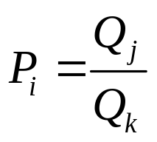
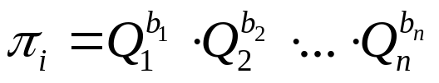
Nondimensional quantities
Simplex:
Complex:

Slide 6
Buckingham's Theorem
n physical variables q₁,…,q_{n}
  Model: f(q₁,…,q_{n}) = 0
k fundamental physical units
p = n – k dimensionless parameters
complex π₁,…,π_{p}
  Model: F(π₁,…,π_{p}) = 0
  Plus simplex P_{i}

Slide 7
Buckingham's Theorem
The mathematical model not necessary
Only “relevant” quantities
BT provides method
Dimensional matrix
Not unique chose the most “physically meaningful”

Slide 8
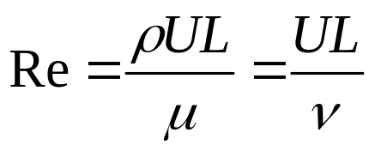
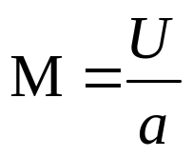
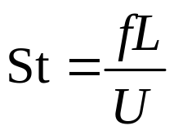
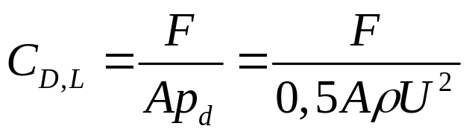
Nondimensional numbers in Mechanics of Fluids
Reynolds number
Mach number
Strouhal number
Force coefficients
Inertial forces
Viscous forces
Compressibility effects
Nondimensional frequency

Slide 9
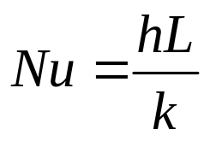
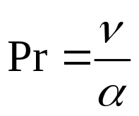
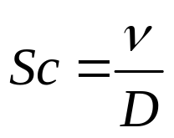
Nondimensional numbers in Thermodynamics
convective heat transfer coefficient
Nusselt number
Prandtl number
Schmidt number
Convective heat transfer coeff.
Conductive heat transfer coeff.
thermal conductivity
kinematic viscosity
Momentum diffusivity
Thermal diffusivity
thermal diffusivity
kinematic viscosity
Viscous diffusion rate
Molecular (mass) diffusion rate
mass diffusivity

Slide 10
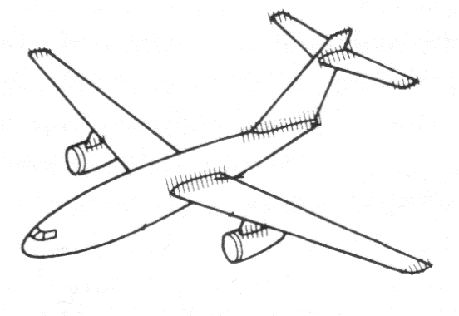

Physical modeling
object
model
parameters
results
Similarity
  Geometrical (simplex)
  Physical (complex)

Slide 11


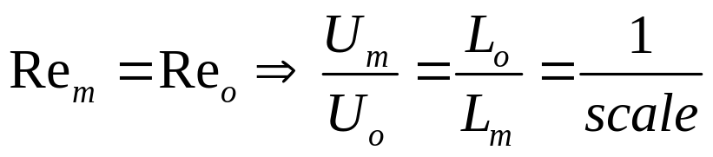
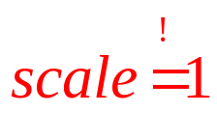
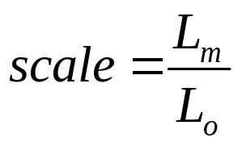

Physical modeling
Reynolds number
Mach number
Modelling

Slide 12
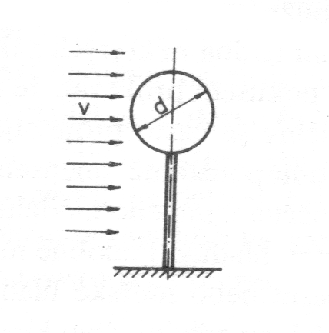
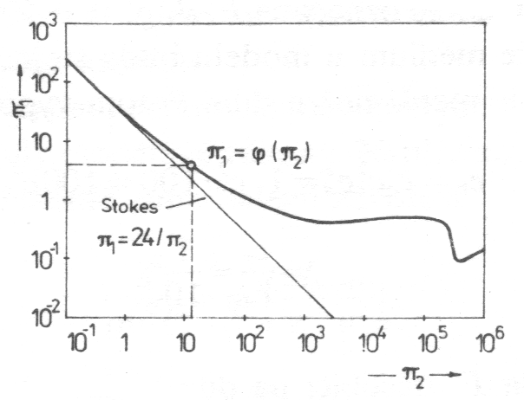
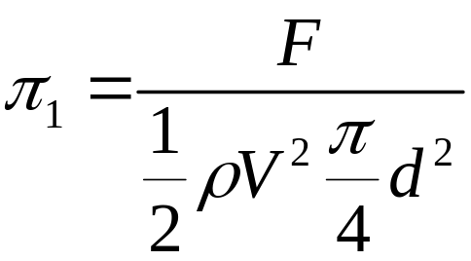
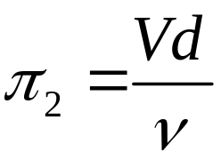
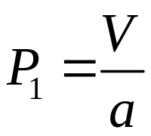
Example sphere in flow
Relevant quantities
F[kg.m/s²], V[m/s], d[m], ρ[kg/m³], ν[m/s²], a[m/s]
F = f(V,d,ρ,ν,a)
Nondimensional parameters:
Re
C_{D}
M

